Slide 1
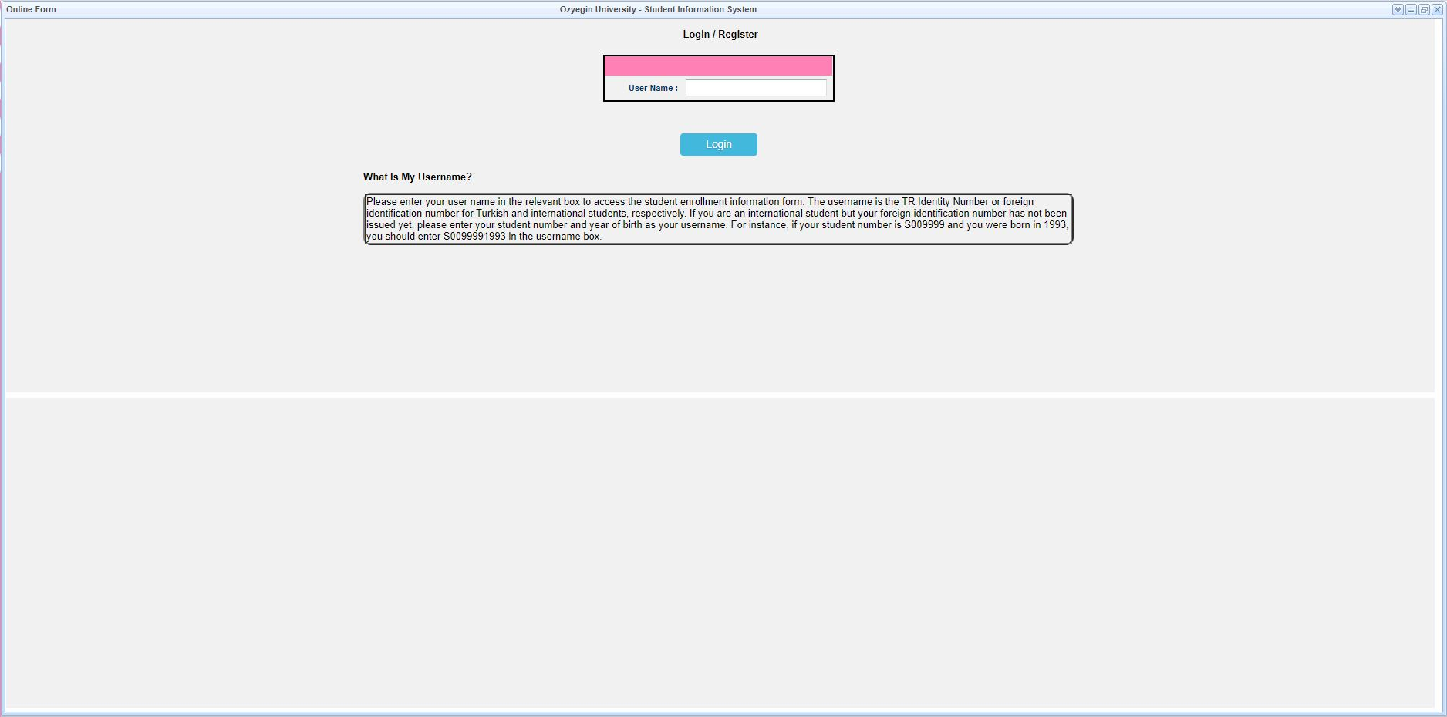
Online Information Form Content
Inside the box, it says what you can use as a username. Please read carefully! Enter your username and press the "Login" button

Slide 3
Here is your OZU e-mail address. For students with a single name, the e-mail address is normally formed as name.surname@ozu.edu.tr. Students with two names can change the suggested e-mail address they will use at this stage.
When you finish controlling the page, you can proceed to the next page by pressing the "Save and Next" button.

Slide 4
To enter a new address, select for example, "Home" in the Type section and write your home address in the Address line. Then, when you press the Add/Update button, your address will be reflected in the window above.
If you want to change an address in the window, when you select the line, the information is reflected in the section below. You can enter the information you want to update and press the Add/Update button again.
The MERNIS address comes automatically. It is not available to every student.

Slide 5
To enter a phone number, for example, select "Mobile" in the Type section. If you have a number as 0532 111 11 11, enter 532 in the Area Code section without 0, and 111 11 11 in the Phone section. Then, when you press the Add/Update button, your phone number will be reflected in the window above. If you want to change a number in the window above, when you select this line, the information is reflected in the section below. You can enter the information you want to update and press the Add/Update button again.

Slide 6
The phone and e-mail addresses of at least two people who will be contacted in an emergency should be entered. To enter a phone number, if it is 0532 111 11 11, 532 is entered in the Field Code section without 0, and 111 11 11 is entered in the Telephone section. Then, when you press the Add/Update button, the information will be reflected in the above window. After entering the information of the second person, press the Add/Update button. After making sure that there are two people's information in the above window, you can proceed to the next page with the Save and Next button.

Slide 7
Only students who have studied at a university before will enter information in this field. If you do not have a university education before, you can leave this field blank and press the "Save and Next" button.

Slide 8
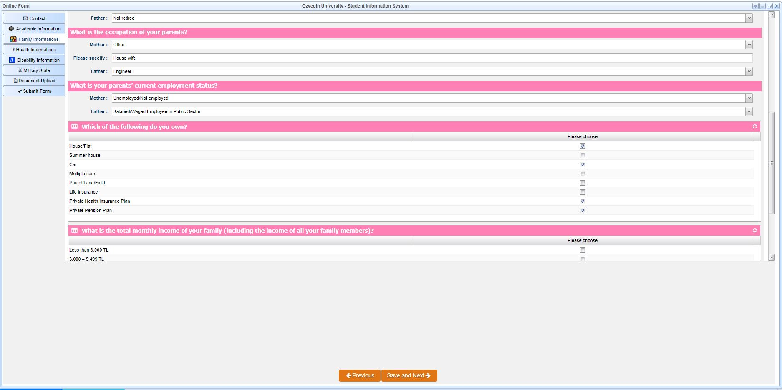
Information about your family is filled in this section. If any, the number of your siblings, education information, relatives of martyrs / veterans, etc. information is entered in this field. After filling all the fields in the Family Information section, you can proceed to the Health Information section with the Save and Next button.

Slide 9
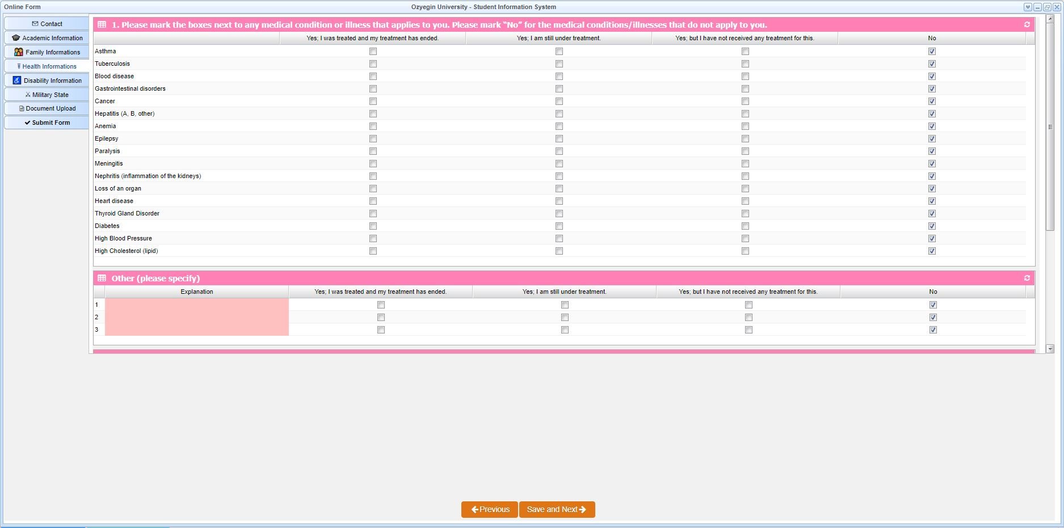
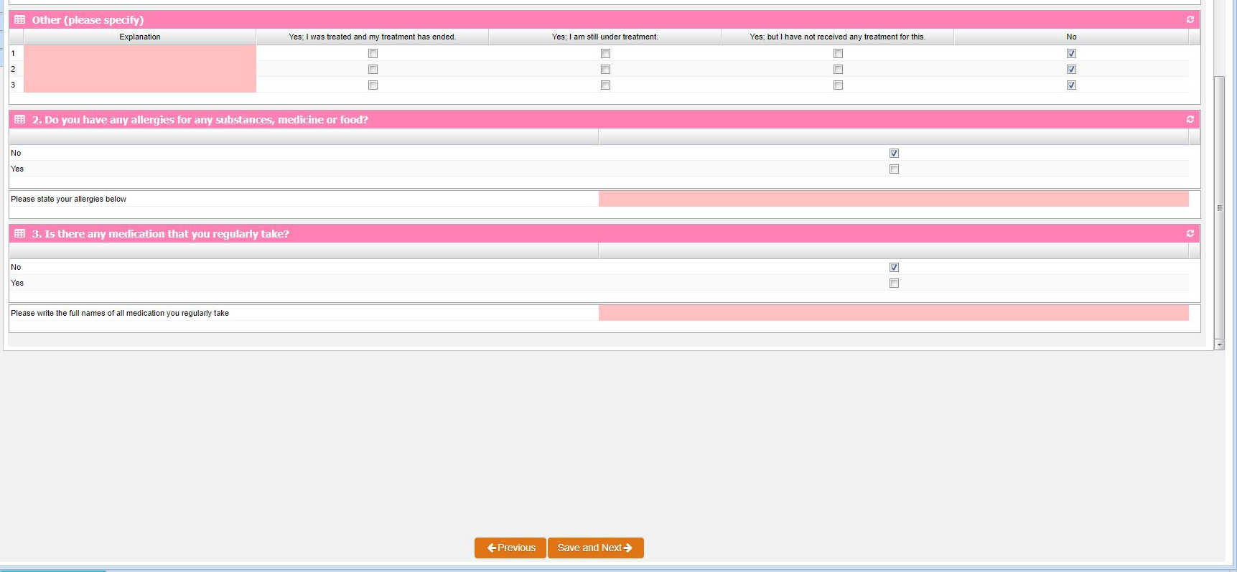
In the Health Information section, tick if there is a disease you have had or are currently being treated for, if not, select No. After all the selections are completed, you can switch to the Disability Information section by clicking the Save and Proceed button.

Slide 10
If you only have a disability, select and mark the relevant disability type, if not, you can leave this section blank and press the "Save and Next" button.

Slide 11
This tab appears for male student with Turkish nationality. Choose one of the options according to your situation and proceed by pressing the "Save and Proceed" button.

Slide 12
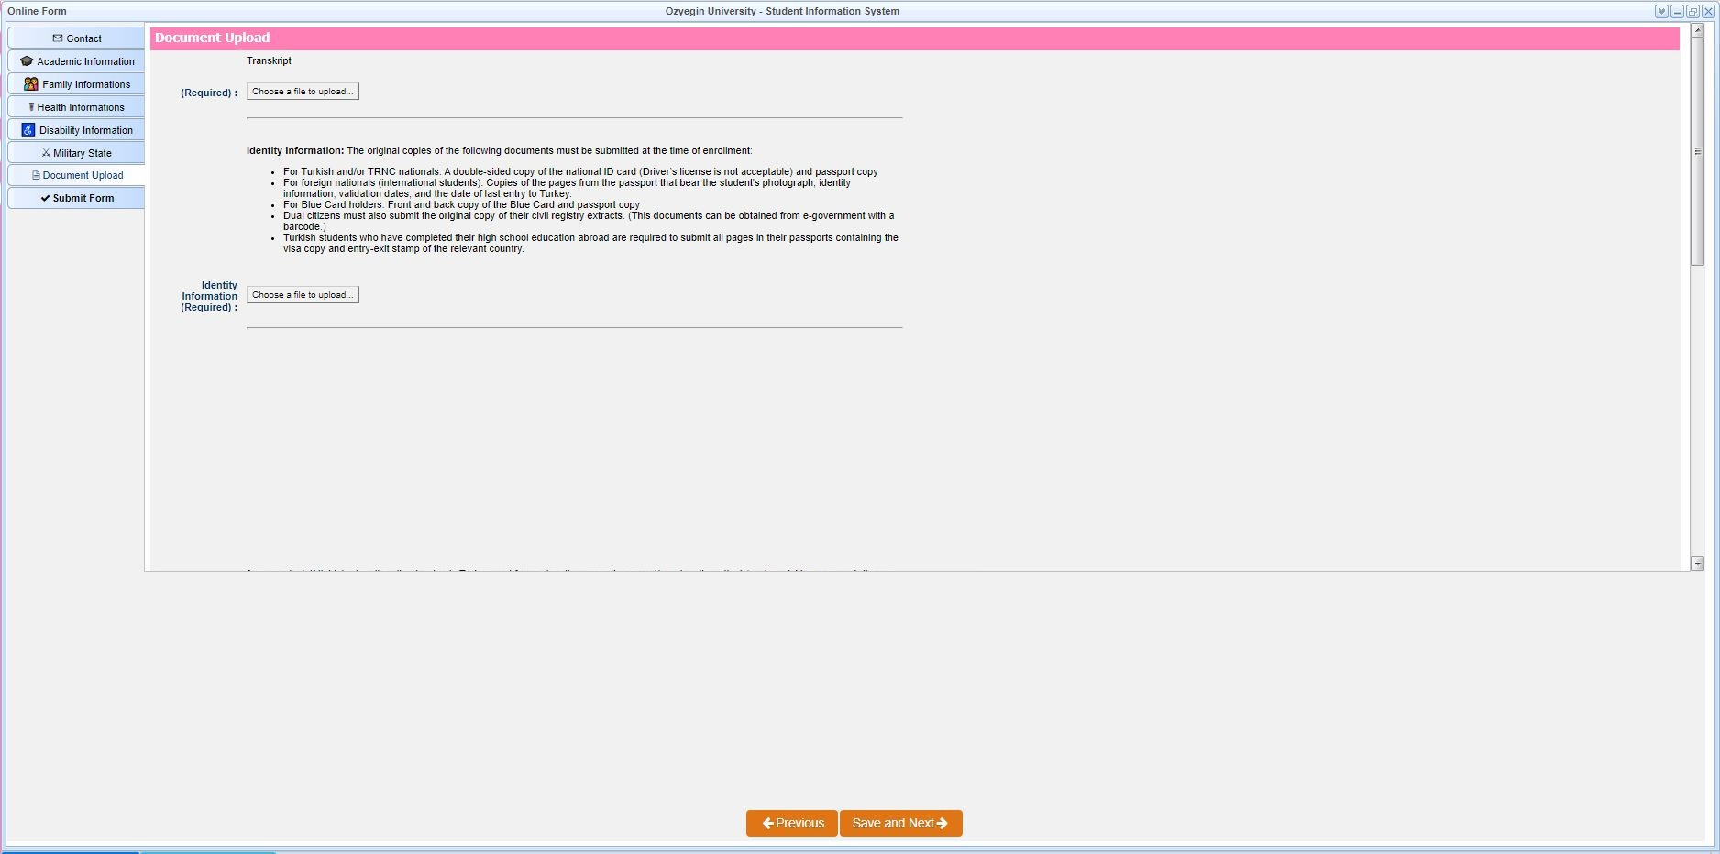
Document Upload section appears for students who are enrolled in programs that require documents. Here, the required documents or optional documents vary according to the program you will enroll.
Upload the requested documents in pdf format and your photo in jpg format.
If you want to change the document you uploaded before, you can upload it again by clicking the "Choose a file to upload" button.

Slide 13
At the end of the form, there are Personal Data Protection Law approval texts and information about the continuation conditions of the Scholarship and Discount, if any. Your Online Information Form will be completed when you press the «Submit Form" button after giving the relevant approvals.

